Slide 1
Content Management System – Two Arrow View
Test Pass 1
Total:
20
Test Pass 2
Total:
15
Test Pass 1
Fail
Test Manager : Deepak Ratnani
Pass
Fail
Pass
Group:
Content Management Group
Portfolio:
Content Management
Version:
1.1
5
5
5
10
Not Completed:
Test Pass 3
Total: 8
Test Pass 4
Total: 25
10
Start Date:
10-12-2014
Passed:
5
End Date:
10-16-2014
Pass
Failed:
5
Active Testers:
4
Fail
Description/Comments
Fail
This is a sample test description
Pass
0
7
15
5
Data View
Test Pass Name
Test Manager
Group
Portfolio
Version
Not Completed
Failed
Detailed View
Passed
End Date
Test Pass 1
Deepak Ratnani
Content…
Content…
1.1
10
5
5
10-16-2014
Detailed View Link
Test Pass 2
Preeti Walde
Content…
Content…
1.1
0
5
10
10-16-2014
Detailed View Link
Test Pass 3
Ekta Choudhary
Content…
Content…
1.1
1
0
7
10-16-2014
Detailed View Link
Test Pass 4
Ashok Mishra
Content…
Content…
1.1
10
15
5
10-16-2014
Detailed View Link

Slide 2
Reporting Center CIO Scorecard
Content Management System – CIO View
Content Management System – CIO View
Test Pass 1
Total: 20
Test Pass 1
Not Completed: 10 Passed: 5 Failed: 5
Test Manager : Deepak Ratnani
Group:
Content Management Group
Test Pass 2
Total: 15
Portfolio:
Content Management
Passed: 5 Failed: 10
Version:
1.1
Not Completed:
Test Pass 3
Total: 8
10
Start Date:
10-12-2014
Passed:
5
End Date:
10-16-2014
Passed: 0 Failed: 7
Failed:
5
Active Testers:
4
Description/Comments
Test Pass 4
Total: 25
This is a sample test description
Not Completed: 5 Passed: 15 Failed: 5
Data View
Test Pass Name
Test Manager
Group
Portfolio
Version
Not Completed
Failed
Detailed View
Passed
End Date
Test Pass 1
Deepak Ratnani
Content Management Group
Content Management
1.1
10
5
5
10-16-2014
Detailed View Link
Test Pass 2
Preeti Walde
Content Management Group
Content Management
1.1
0
5
10
10-16-2014
Detailed View Link
Test Pass 3
Ekta Choudhary
Content Management Group
Content Management
1.1
1
0
7
10-16-2014
Detailed View Link
Test Pass 4
Ashok Mishra
Content Management Group
Content Management
1.1
10
15
5
10-16-2014
Detailed View Link

Slide 3
Reporting Center Bar Graph
Content Management System – Bar Graph
Data View
Test Pass Name
Test Manager
Group
Portfolio
Version
Not Completed
Failed
Detailed View
Passed
End Date
Test Pass 1
Deepak Ratnani
Content…
Content…
1.1
10
5
5
10-16-2014
Detailed View Link
Test Pass 2
Preeti Walde
Content…
Content…
1.1
0
5
10
10-16-2014
Detailed View Link
Test Pass 3
Ekta Choudhary
Content…
Content…
1.1
1
0
7
10-16-2014
Detailed View Link
Test Pass 4
Ashok Mishra
Content…
Content…
1.1
10
15
5
10-16-2014
Detailed View Link

Slide 4
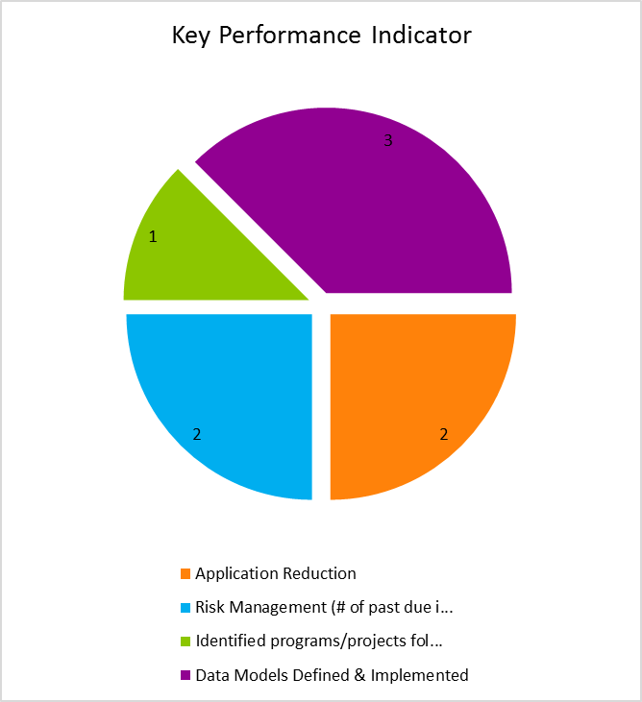
Reporting Center Pie Chart
Content Management System – Pie Chart
Application Reduction
Test Pass 1
Test Manager : Deepak Ratnani
Actual:
22 Gal
Period :
September
Target:
22 Gal
Objective:
Strengthen Partnerships
Group:
Content Management Group
Portfolio:
Content Management
Description/Comments
Version:
1.1
Not Completed:
10
Start Date:
10-12-2014
Passed:
5
End Date:
10-16-2014
Failed:
5
Active Testers:
Description/Comments

